Slide 1

DAYANANDA SAGAR COLLEGE OF ENGINEERING,
SHAVIGE MALLESHWARA HILLS, K.S. LAYOUT, BANGALORE -560078.
DEPARTMENT OF COMPUTER SCIENCE AND ENGINEERING
PROJECT :- AUTOMATED DOOR BELL
BY:-
P.SAI PRANEETH -1DS18CS135
B.SAI VARDHAN REDDY -1DS19CS401
GUIDE:- Prof.Manasa
D. SAKETH – 1DS18CS111
SANGATI SAI ROHITH REDDY-1DS18CS113

Slide 2
PROJECT ABSTRACT :
Security has always been an important issue in the home or office.
A remote home security system offers many more benefits apart from keeping home owners, and their property, safe from intruders.
The system is composed of the Doorbell interfaced with Raspberry pi.
Due to corona not many people prefer touching things in public, the door bell consists of an ultra sonic sensor which senses a person in front of the door with in 40 cm and ring the bell automatically.

Slide 3
PROJECT ABSTRACT :
Whenever the person thinks there is none to respond to the door bell then he can press the doorbell, the camera gets triggered and captures their face and sends the picture of the person to the owners email.
The pictures can be seen later on through firebase database for better surveillance.

Slide 4
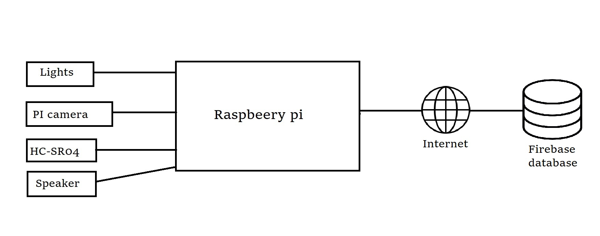
SYSTEM DESIGN :-

Slide 5
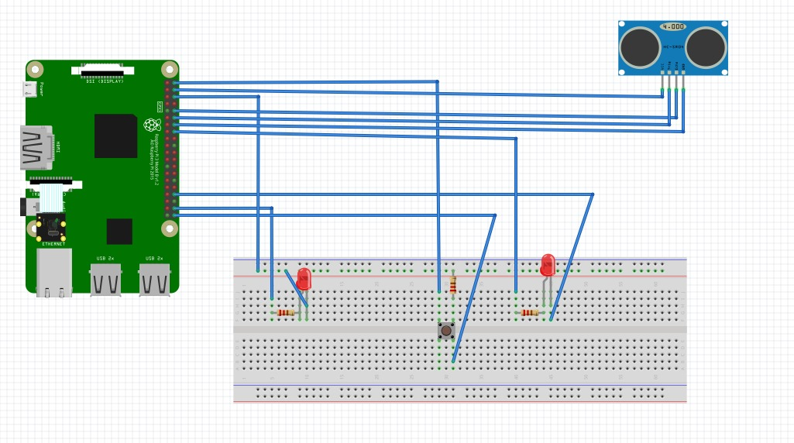
CIRCUIT DesiGn :-

Slide 6
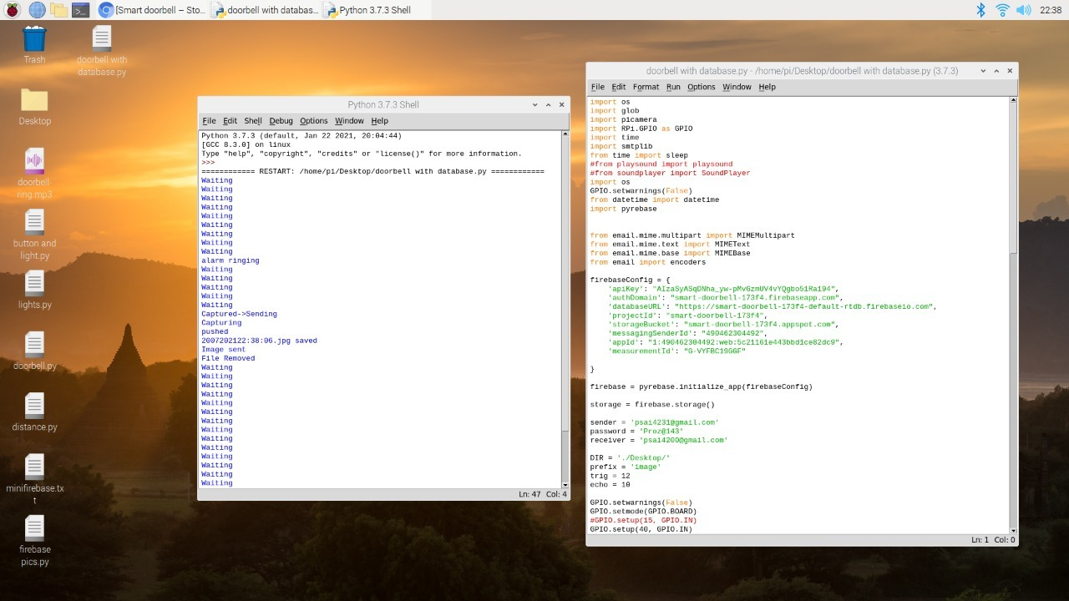
code and execution :-

Slide 7
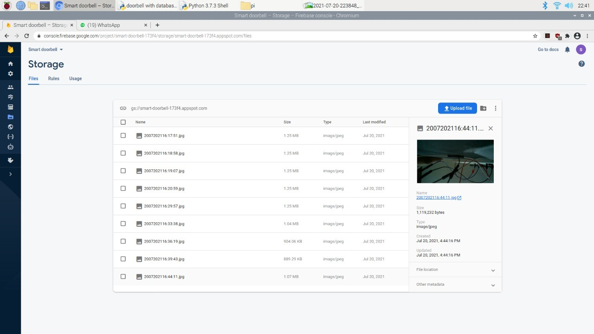
Database :-

Slide 8
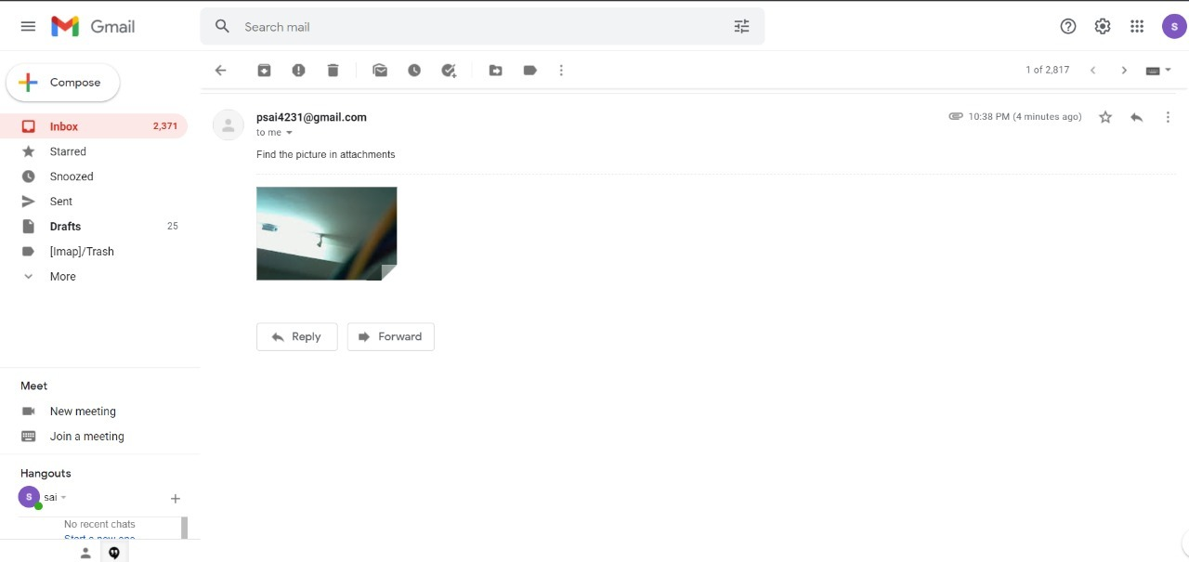
Email :-

Slide 9
Thank You

